Slide 1
ENEM e VESTIBULARES
Notes:
S

Slide 2
IS BURNOUT REAL?
Last week, the World Health Organization upgraded burnout from a “state” of exhaustion to “a syndrome” resulting from “chronic workplace stress” in its International Disease Classification. That is such a broad definition that it could well apply to most people at some point in their working lives. When a disorder is reportedly so widespread, it makes me wonder whether we are at risk of medicalizing everyday distress. If almost everyone suffers from burnout, then no one does, and the concept loses all credibility. By Richard A. Friedman
I'm sure the author's generation also experienced workplace stress. However, his generation also experienced real economic stability and socioeconomic gains. There was a light at the end of the tunnel. Currently, we are working tirelessly towards what ends? There doesn't seem to be a light at the end of the tunnel. The burnout is psychological and existential as much as it is physical.
Anna B. – New York, June 4, 2019

Slide 3
01. (UNICAMP) Em seu comentário, a leitora Anna B. discorda do autor do texto quanto à
a) existência de burnout em gerações passadas.
b) influência da economia no avanço de burnout.
c) prevalência de burnout no ambiente de trabalho.
d) gravidade de burnout nas condições atuais.

Slide 4
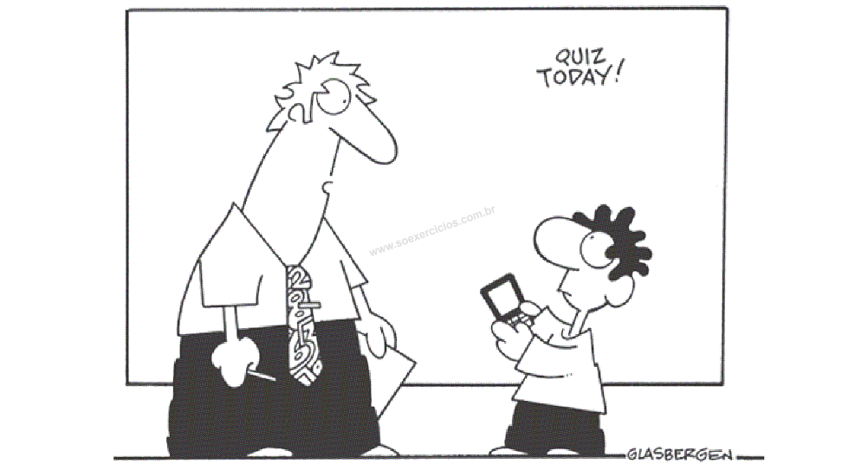
02. (UNEB) The boy in this cartoon
a) isn’t familiar with high-tech devices.
b) would rather not go regularly to school.
c) wants the teacher to follow him on Twitter.
d) would like to use his tablet in class.
e) refuses to leave his tablet outside the classroom.
“You have to attend classes. You can't just follow me on Twitter.”

Slide 5
Em uma entrevista, a escritora nigeriana
Ayobami Adebayo refletiu sobre os personagens
principais (Yejide e Akin) e o contexto sociopolítico
de seu romance Stay With Me.
While writing, I also started thinking about the middle class in Nigeria. When Yejide visits her mother-in-law, there’s a very low fence in front of their house. It’s barely a fence. When Yejide and Akin build their own house in the early nineties, they erect a fence that’s higher than the house. You can’t see inside. That was something I observed about architecture in Nigeria—that at some point, probably in the eighties and nineties, when things became quite turbulent and there was all of this insecurity, one of the ways the people who could afford to insulate themselves against what was going on did was to build higher fences, to use money as a shield in a sense. I wanted that political turbulence to play in the background.

Slide 6
03. (UNICAMP) Segundo a autora, as casas e as cercas na Nigéria representam
a) a desigualdade social e seus impactos para a turbulência política enfatizada no romance.
b) a tentativa da classe média de exercer um impacto na realidade política nos anos 1980 e 1990.
c) o poder aquisitivo da classe média e sua tentativa de se distanciar da realidade política.
d) a violência e a corrupção dos anos 1980 e 1990 e seus impactos nos personagens do romance.

Slide 7
What is Distance Learning and Why Is It So Important?
Distance learning – any form of remote education where the student is not physically present for the lesson – is booming thanks to the power of the Internet. In fact, there are a number of advantages of learning remotely over even traditional teaching models. As the Internet blurs the line between near and far, distance learning is set to disrupt the current paradigm of education.
Historically, distance learning described correspondence courses in which students would communicate with their schools or teachers by mail. More recently, distance education has moved online to include a huge range of systems and methods on practically any connected device.
Distance education is clearly different from regular education in terms of a student or teacher‘s physical presence. For the most part, it translates into increased freedom for both learners and educators, but it also requires higher degrees of discipline and planning to successfully complete the course of study.

Slide 8
The enhanced freedom of remote learning is most clearly seen in the fact that students can choose courses that fit their schedules and resources. (Teachers can do the same.) And in the case of digital learning, students can also choose the location and teaching styles that best suit their needs.
Remote education is certainly not a magic bullet and there will always be a place for in-class learning. At the same time, distance learning still has a lot of untapped potential to reach students where they are and connect educators and learners in new ways. From increased flexibility to new learning styles, it seems that the future of learning will be as diverse in time and place as it will be in thought.
Disponível em: https://www.viewsonic.com/library/education/what-is-distance-learning-and-why-is-it-so-important/. Texto adaptado. Acesso em: 20 set. 2020.

Slide 9
04. (UPE) Considering the author‘s point of view, distance learning is
a) not bringing changes to the teaching and learning process.
b) a teaching and learning process based on face-to-face interaction.
c) a type of course that students have by mail nowadays.
d) any form of remote education using any connected device.
e) a kind of education that needs physical presence of teachers and students.

Slide 10
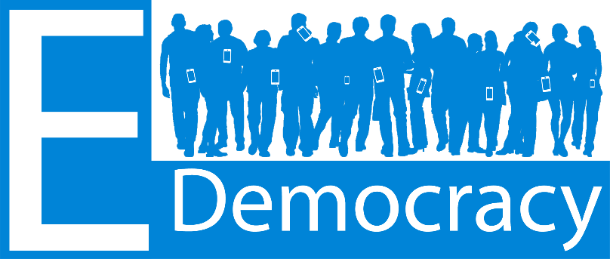
The phenomenon E-democracy [electronic democracy] is well known and well used in Sweden. E-democracy is a solution that makes it easier for the population to vote or to participate in different questions, or just to make themselves heard. E-democracy is used a lot of municipalities as a simple way for the inhabitants to participate in the local debate. E-democracy is often argued as a tool that makes participation more available for everyone.
(“E-democracy and digital gaps”. www.svekom.se)

Slide 11
05. (UNESP adaptado) The tool presented in the excerpt refers to a characteristic of Athenian politics in the classical period, which concerns
a) to the unrestricted power of a single individual.
b) to the weight of rhetoric in decision-making in the polis.
c) to the sovereign decision of a religious leader.
d) to the dominance of a financially privileged group.
e) equal participation in political decisions.

