Slide 1
ENEM e VESTIBULARES
Notes:
S

Slide 2
Opera refers to a dramatic art form, originating in Europe, in which the emotional content is conveyed to the audience as much through music, both vocal and instrumental, as it is through the lyrics. By contrast, in musical theater an actor's dramatic performance is primary, and the music plays a lesser role. The drama in opera is presented using the primary elements of theater such as scenery, costumes, and acting. However, the words of the opera, or libretto, are sung rather than spoken. The singers are accompanied by a musical ensemble ranging from a small instrumental ensemble to a full symphonic orchestra.
Disponível em: <http://www.grammarbank.com/short-reading-comprehension-passages.html>

Slide 3
01. (PUCPR adaptado) De acordo com o texto,
a) A ópera é uma forma de arte dramática onde os atores falam suas falas usando cenários, figurinos e atuação.
b) Ópera é uma performance dramática onde os atores cantam e dançam acompanhados por um conjunto musical que vai desde um pequeno conjunto instrumental até uma orquestra sinfônica completa.
c) A ópera é uma forma de arte dramática onde o conteúdo é transmitido por meio de música vocal e instrumental e é cantado, podendo-se ver os elementos de cenário, figurino e atuação.
d) A ópera é uma forma de arte dramática onde a música desempenha um papel menor.
e) Ópera é uma forma de arte dramática em que a performance dramática de um ator é primária, assim como o cenário, figurinos e atuação.

Slide 4
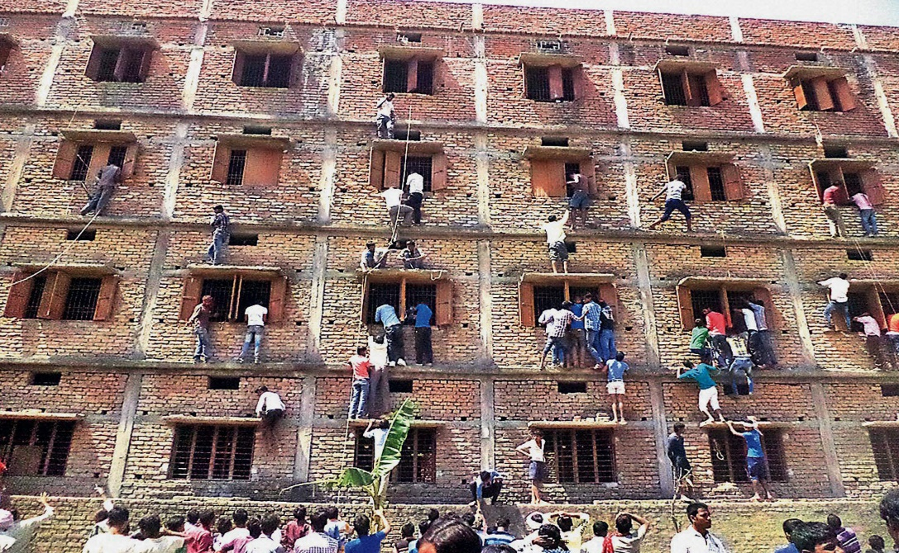

Slide 5
India Cheating Scandal: 600 Students Expelled at Bihar Schools
More than 600 students have been expelled from school in India amid widespread cheating — with some having friends scale the walls of exam centers to pass notes through windows, officials said Friday. The students were among more than 1.4 million high school students taking their 10th grade school finals in the eastern state of Bihar. Many of those caught cheating had smuggled textbooks or scraps of paper to be used for cheating, police and education officials said. Friends, parents and other relatives of the teenagers were seen climbing the sides of some exam centers on Wednesday and Thursday as they tried to reach the windows of the classrooms where the students were taking their exams. They appeared to be trying to pass on cheat sheets with answers written on them. Bihar's education minister, P K Shahi, said the scale of the cheating made it impossible for officials alone to contain and that families should help.
Disponível em:: <http://www.nbcnews.com/news/world/six-hundred-students-caught-cheating-bihar-india-schools-n327066>

Slide 6
02. (PUCPR) According to the text, choose the alternative which shows the CORRECT sequence of T (true) or F (false).
I. 600 students quit school.
II. Families tried to help the students to cheat.
III. In the education minister’s perspective, it turned out to be ok the families’ help.
IV. At least 1.4 million students were taking the test.
V. They took this test because they did not have good grades during the semester.
a) F – F – T – T – F.
b) T – F – F – T – T.
c) F – F – T – F – F.
d) F – T – T – T – F.
e) T – T – F – T – T.

Slide 7
03. (FUVEST adaptado) Reconhecida como grande poetisa norte-americana e figura influente da cultura afroamericana, Maya Angelou lutou pelos direitos civis e pela igualdade depois de superar um trauma na infância. Os versos do poema de sua autoria...
a) afirmam os sentimentos de autonomia e autossuficiência.
b) mostram a derrota diante das dificuldades.
c) expressam o resultado das reflexões feitas.
d) indicam a distância intransponível entre amigos.
e) mostram arrependimento em relação às decisões do passado.
Lying, thinking
Last night
How to find my soul a home
Where water is not thirsty
And bread loaf is not stone
I came up with one thing
And I don't believe I'm wrong
That nobody,
But nobody
Can make it out here alone
Alone - Maya Angelou

Slide 8
Bypassed by the rescue
In a pandemic that’s wreaked widespread economic havoc, Cleveland has been among the hardesthit cities in the U.S. And at a time when the U.S. is engaged in another conversation about its foundational racial inequalities, not much of Washington’ $2 trillion has reached Cleveland’s predominantly Black neighborhoods.

Slide 9
04) (FGV adaptado) Ao comparar o texto e os gráficos é possível afirmar que
a) a ajuda fornecida pelo governo ampliou a porcentagem de famílias negras americanas que possuem suas casas.
b) a disparidade racial em Cleveland não diminuiu nos primeiros meses da pandemia de Covid-19.
c) a ajuda financeira de Washington mitigou antigos desequilíbrios raciais no país.
d) os bairros minoritários foram os menos penalizados de todos em Cleveland.
e) o governo deve ser responsabilizado pelo alto número de casos de Covid-19 entre negros americanos.

Slide 10
We are at the beginning of a long road to rethinking and rebuilding supply chain models to encompass not just financial priorities but also business operations continuity in the most trying of circumstances. Executives from France and Italy, for example, are discussing ways to remake their businesses in the wake of the Covid-19 pandemic. Their specialty is supply chains. They are smart people at the core of the world’s most sophisticated and valuable systems of manufacture, shipment, and inventory, and yet many of their supply systems staggered in the past few months – the byproduct of reliance on old business models.
(Antonio Gulli. www.forbes.com, 28.07.2020. Adapted.)

Slide 11
05. (FGV) One problem concerning supply chains after the outbreak of Covid-19 relates to
a) the way the pandemic has thoroughly affected supply businesses.
b) the resistance of top executives to redesign existing business paradigms in novel circumstances.
c) the long-term difficulty in establishing financial priorities in the supply chain business.
d) the instability of supply systems which still follow old business models.
e) the sophistication of supply chain processes, which renders innovation onerous.

