Slide 1
Resolução de Questões 05
ENEM e VESTIBULARES
Notes:
S

Slide 2
I ain't gonna work on Maggie's farm no more
I ain't gonna work on Maggie's farm no more
Well, I wake up in the morning
Fold my hands and pray for rain
I got a head full of ideas
That are drivin' me insane
It's a shame the way she makes me scrub the floor
I ain't gonna work on Maggie's farm no more
Well, he hands you a nickel
He hands you a dime
He asks you with a grin
If you're havin' a good time
Then he fines you every time you slam the door
I ain't gonna work for Maggie's brother no more
I ain't gonna work for Maggie's pa no more
No, I ain't gonna work for Maggie's pa no more
Well, he puts his cigar out in your face just for kicks
His bedroom window it is made out of bricks
The National Guard stands around his door
Ah, I ain't gonna work for Maggie's pa no more, alright

Slide 3
(FUVEST adaptado) In these stanzas, the set of scenes described shows that the main difficulty experienced by the person whose story is told in the lyrics of the song refers to
a) difficult relationship with family and friends.
b) lack of creativity in the face of work demands.
c) the restrictions imposed on their freedom and personal expression.
d) competition for higher wages with co-workers.
e) the difficulties of living outside a large urban center.

Slide 4
All aboard the flat earth cruise – just don’t tell them about nautical navigation
A group of people who believe the Earth is flat have announced their “boldest adventure yet”: a Flat Earth cruise scheduled for 2020. Flat earthers will enjoy swimming pools and perhaps even an artificial surf wave. There’s just one problem for those celebrating the flatness of the Earth. The navigational systems cruise ships, and other vessels, use rely on the fact that the Earth is not flat. “Nautical charts are designed with that in mind: that the Earth is round. GPS relies on 24 main satellites which orbit the Earth to provide positional and navigational information. The reason why 24 satellites were used is because of the curvature of the Earth,” said Henk Keijer, a former cruise ship captain who sailed all over the globe during a 23-year career. “At least three satellites are required to determine a position. But someone located on the other side of the Earth would also like to know their position, so they also require a certain number of satellites. Had the Earth been flat, a total of three satellites would have been enough to provide this information to everyone on Earth. But it is not enough, because the Earth is round.”

Slide 5
02. (UNICAMP) A respeito do fato noticiado, o autor do texto ressalta
a) uma contradição.
b) uma confirmação.
c) um equívoco da ciência.
d) uma inversão de valores.

Slide 6
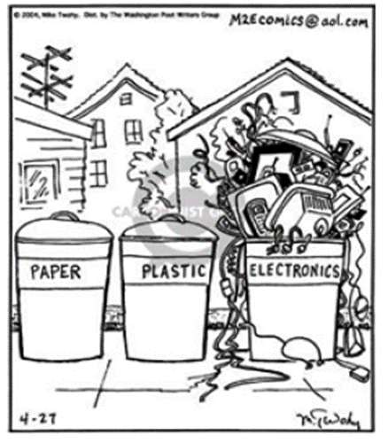
(CECIERJ) If I wanted to discard an old flashdrive, a few margarine tubs, and written post-it, where should I place these items, respectively,
a) electronics, paper, and plastic bins.
b) electronics, plastic, and paper bins.
c) paper, electronics, and plastic bins
d) electronics and paper bins.
e) paper bins, paper and electronics.

Slide 7
As astronomers gaze into the depths of space, they do so with unease: They don’t know precisely what the universe is made of.
Surprisingly, no one knows the stars’ exact chemical composition: how many carbon, nitrogen and oxygen atoms they have relative to hydrogen, the most common element.
These numbers are crucial, because they affect how stars live and die, what types of planets form and even how readily life might arise on other worlds.
Twenty years ago, astronomers expressed confidence in the numbers they had been working with. Now, not so much. The problem lies not in the far corners of the cosmos, but much closer to home. Astonishingly, scientists don’t know exactly what the sun is made of. As a result, they don’t know what the other stars are made of, either.

Slide 8
“The sun is a fundamental yardstick,” says Martin Asplund, an astrophysicist at the Max Planck Institute for Astrophysics in Garching, Germany. “When we determine the abundance of a certain element in a star or a galaxy or a gas cloud anywhere in the universe, we use the sun as a reference point.”
The sun’s location in the Milky Way also makes it a good representative of the entire galaxy. most stars in the universe reside in giant galaxies like the Milky Way, which makes the sun a touchstone for the entire cosmos.
For nearly a century, astronomers have judged stars normal or not by seeing whether their chemical compositions match the sun’s. Most stars near us do; some don’t.

Slide 9
(FUVEST) Conforme o texto, um critério tradicionalmente utilizado por astrônomos para avaliar estrelas envolve
a) verificar se sua composição se assemelha à do sol.
b) selecionar galáxias compostas por estrelas padrão.
c) calcular níveis de radiação estelar e de energia gravitacional.
d) medir a densidade e grau de opacidade de nêutrons.
e) testar a circulação atmosférica em torno dos astros.

Slide 10
(FUVEST) Segundo o texto, conhecer a composição de elementos químicos que constituem as estrelas é fundamental, pois ela, entre outros aspectos,
a) fornece evidências da ligação entre as idades das estrelas.
b) sugere a existência de planetas rochosos formados por elementos pesados.
c) influencia na possibilidade de presença de vida em outros locais do universo.
d) determina condições cosmológicas da evolução de aglomerados estelares.
e) possibilita a síntese de moléculas em nuvens de gás e poeira cósmica.

